Slide 1
Human-Robot Collaboration using Commonsense Knowledge in Smart Manufacturing Contexts
CJ Conti
Advisor: Aparna Varde
Co-advisor: Weitian Wang

Slide 2
Introduction
Human-robot collaboration (HRC) is an important part of manufacturing.
Robots need to use commonsense knowledge for enhancing collaborative task execution.
This thesis demonstrates the effectiveness of commonsense knowledge in HRC.

Slide 3
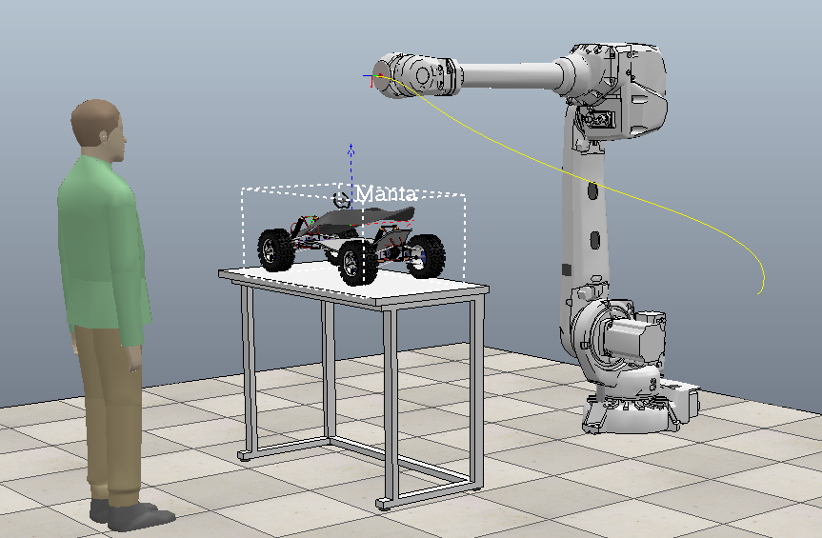
Background and motivation
Collaborative robots have advantages over traditional robots.
To collaborate optimally, robots need to use commonsense knowledge.
Humans use commonsense knowledge naturally.

Slide 4
Contributions of this study
The contributions of our work are:
1. Providing a solution for object assembly with CSK priorities to balance robot execution and aid humans in HRC.
2. Conducting mathematical modeling for robot action planning and arm movement to provide task optimization.
3. Executing simulation tasks in addition to real laboratory experiments in robotics to demonstrate CSK-based-HRC in vehicle manufacturing, extendable to large scale contexts in the smart manufacturing industry.

Slide 5

Commonsense Knowledge Basics
Commonsense knowledge focuses on real-world entities, their connections and how they interact.
Humans naturally use commonsense knowledge.
Robots are much better with factual knowledge.
Robots need to be programmed to use commonsense knowledge.
An example of commonsense knowledge is that a stormy sky clearly indicates rain. [1]

Slide 6
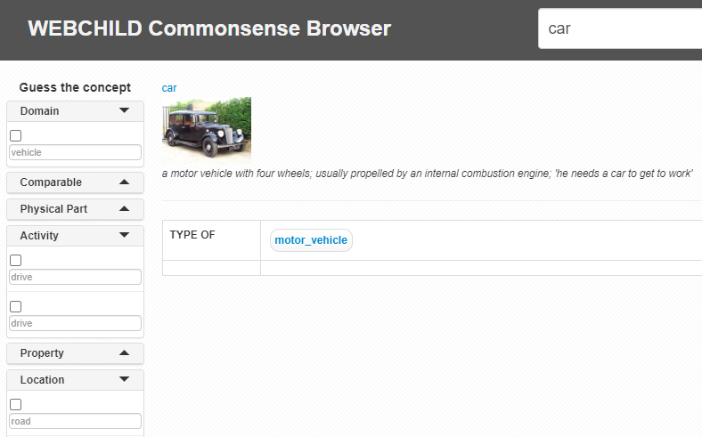
Commonsense Knowledge Bases
YAGO- Utilizes multiple sources effectively.
DBPEDIA- Effectively queries Wikipedia.
ConceptNet- Connects important concepts.
WebChild- Stores, concepts, properties and relationships.

Slide 7
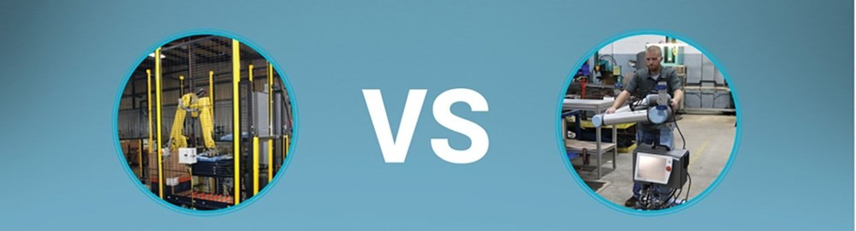
Collaborative robots vs Traditional robots
Less guarding and extra equipment required.
Support human strengths
Work along side humans rather than replacing them.
Traditional Robot(left) and Collaborative Robot(right) [2]

Slide 8
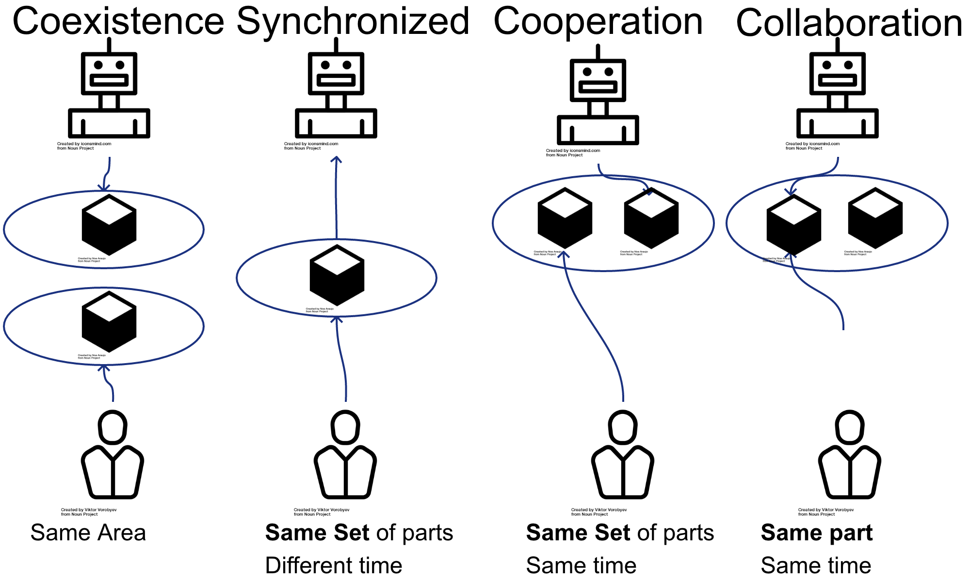
Types of HRC
Coexistence
Synchronized
Cooperation
Collaboration

Slide 9
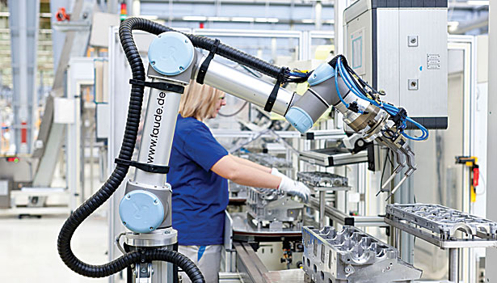
Benefits of HRC
Improved safety and productivity
Tasks robots handle well
Welding-better results and greater safety
Assembling-greater consistency and less monotonous
Paint spraying-greater consistency and productivity
A human and a robot collaborating [3]

Slide 10
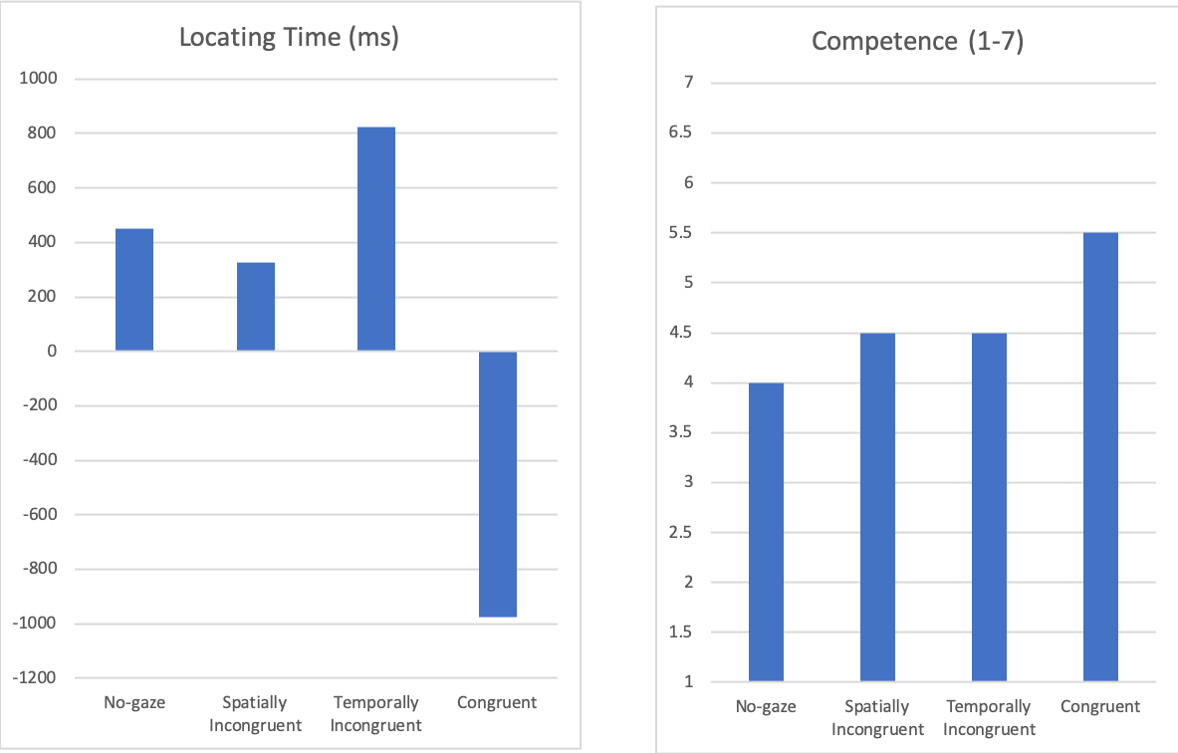
Robot cues
Humans uses cues to communicate.
Different robot cues were tested for HRC: no cue, congruent gaze cue, temporally incongruent gaze cue, spatially incongruent gaze cue.
Congruent phase cue proved optimal

Slide 11
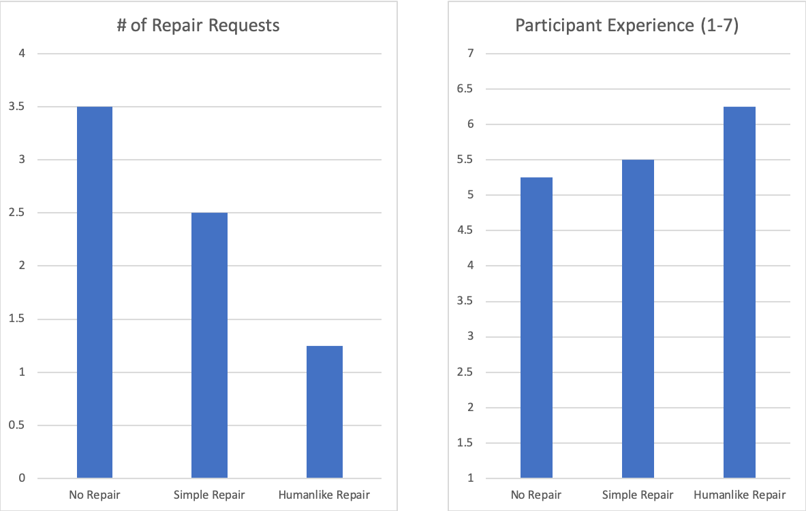
Repair mechanisms
When there are communication issues, humans use repair mechanisms.
Different types of repair mechanisms were tested for HRC: non-existent, simple repair, complex repair.
Complex repair worked best.

Slide 12
Game Interface
Game interfaces are simple and enjoyable to control.
Augmented reality cockpit interface
Presenting information in a simple and clean manner is useful.

Slide 13
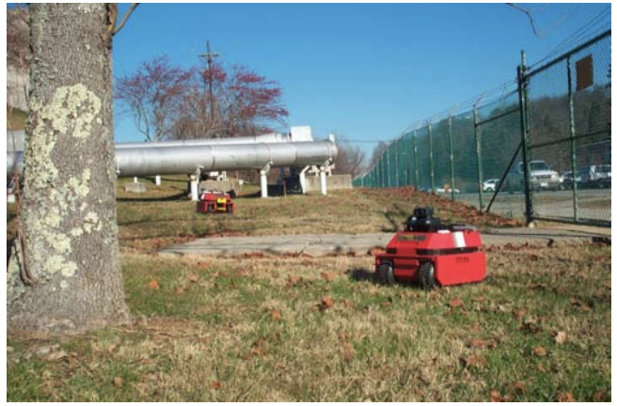
Customizable motion planning
Effective planning allows robots to handle tasks more effectively at a lower cost.
Planning also requires embedding principles.
Principles should focus on maintaining human safety while working optimally
ARTV-Mini all-terrain mobile robots working outdoors [4]

Slide 14
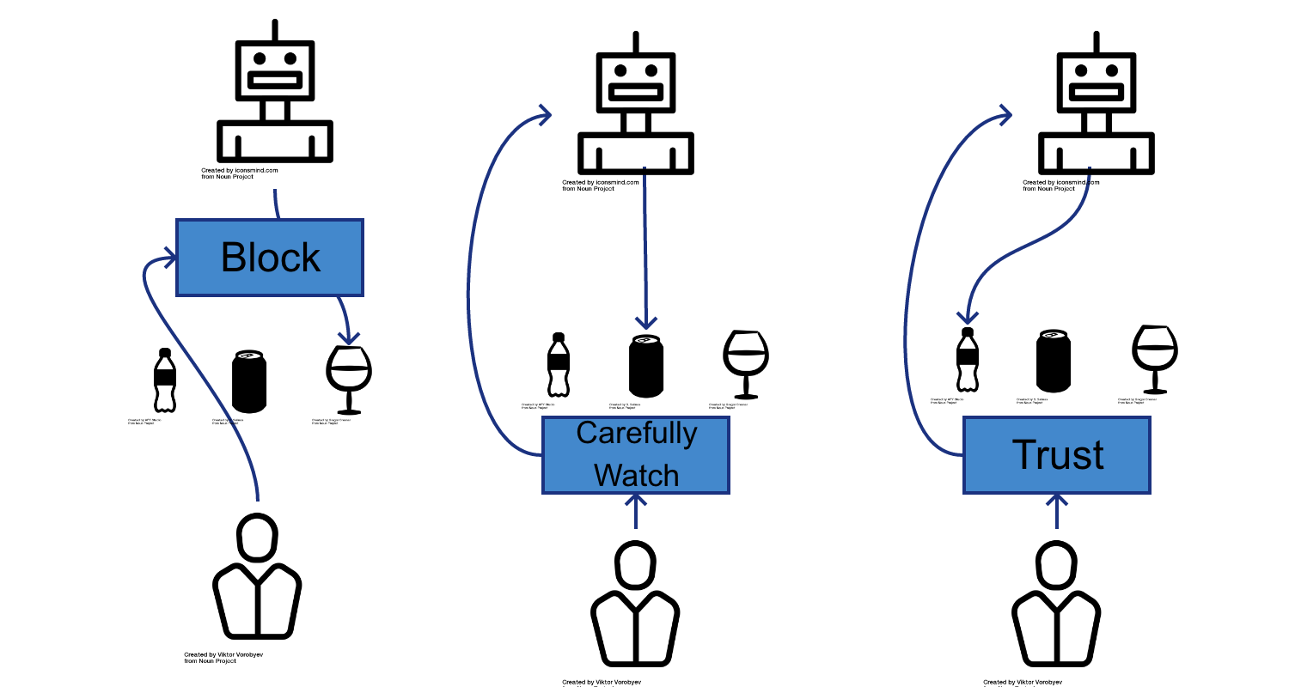
HRC and Trust
Balance for trust is necessary
Table clearing experiment.
Robot focusing on trust vs robot ignoring trust
Robot needs to detect excessive trust

Slide 15
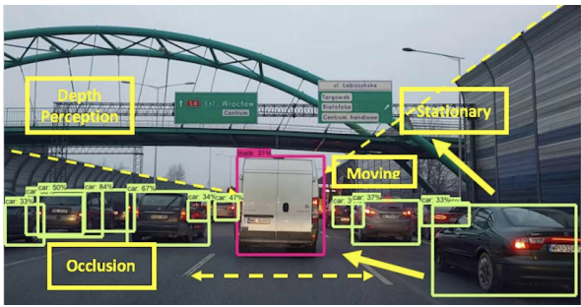
Importance of csk
2016 Tesla vehicle misidentified a truck as an overpass.
CSK systems can help logically determine detected objects.
Storing current information helps for near future.

Slide 16
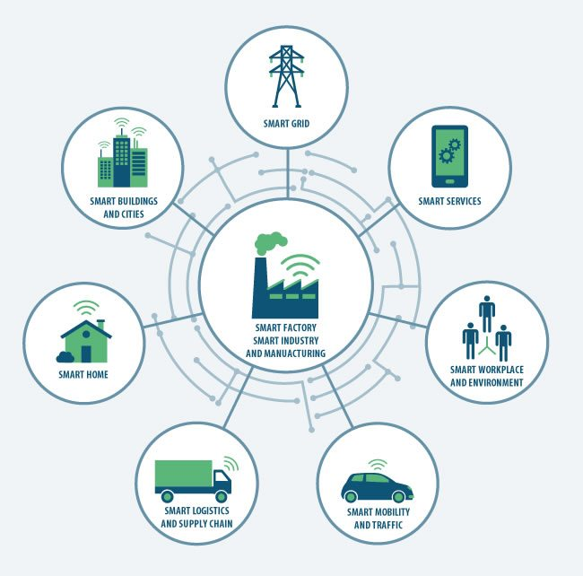
Smart Manufacturing
Entails robotics and artificial intelligence such as robotics learning from demonstration
Potential benefits of smart manufacturing [4]

Slide 17
Need For CSK in HRC
Commonsense knowledge is important in AI processes, e.g. spatial commonsense is highly crucial in object detection.
Automated extraction of CSK is conducted by researchers. The significance of CSK in NLP, vision and robotics is emphasized in AI in many works, e.g. as surveyed in.
Yet researchers have not harnessed CSK in HRC for task optimization, to the best of our knowledge.

Slide 18
Proposed Approach
This thesis outlines how robots can use commonsense knowledge to support humans while collaborating.
The two main solution points are listed as follows.
Determine commonsense priorities that can support and protect humans.
Develop math modeling using CSK priorities to optimize task execution in robot action planning.
Facilitate effective collaborative task execution in terms of human safety, execution & production.

Slide 19
Commonsense knowledge premises
Humans prefer carrying lighter and closer parts due to ease
Humans will carry heavy parts more slowly than light parts.
Humans should handle less stable parts
Humans should not handle dangerous parts
Note- Part refers to an individual component while object refers to the final assembled product.

Slide 20
Reasoning behind premises
Humans will handle heavy parts with more difficulty than light parts
Humans will handle heavy parts more slowly than light parts
Robot mishandling fragile part could be costly
Human safety is most important.

Slide 21
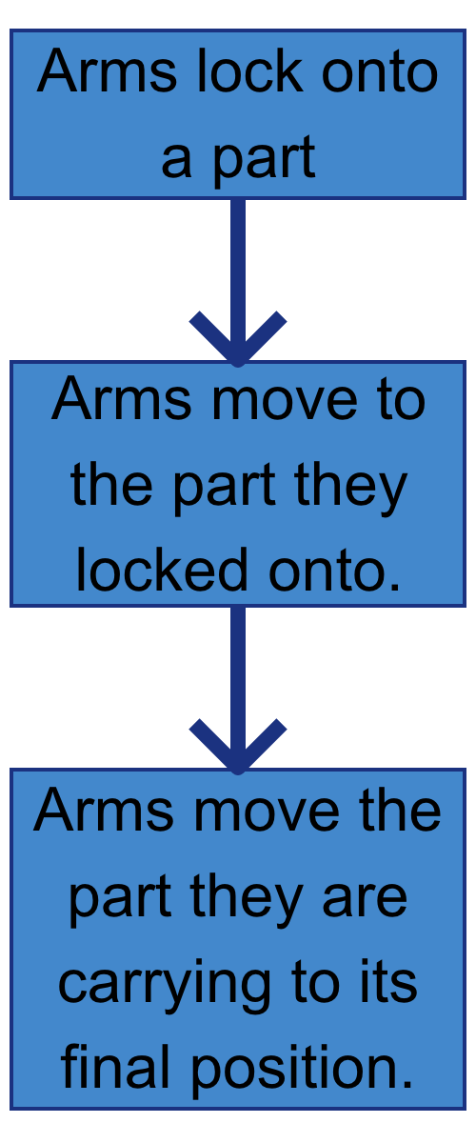
Steps for arms handling parts
Note- ”Arms” refers to the single arm for the robot and a combination of both arms for the human.

Slide 22

Mathematical Modeling
Weighted average-W_{a}(s_{p})=(min_{a}(s_{p})+mean_{a}(s_{p})+max_{a}(s_{p}))//3
Score part 1-$O_{1}\left(p\right)=\sum_{a=1 }^{t}{r\left(a_{min}\right)×W_{a}(s_{p}) /(a\left(p\right))}$
Score part 2-$O_{2}\left(p\right)=\sum_{a=1}^{t}{r\left(a_{max}\right) ×(a(p)/}W_{a}(s_{p}))$
Final score-$O\left(p\right)=O_{1}\left(p\right)+O_{2}(p)$

Slide 23
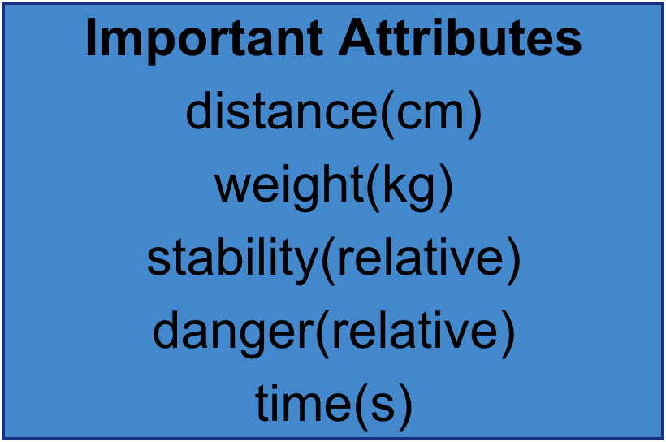
Mathematical Modeling
Important values include
W_{a}(s_{p}) -Weighted average
R(a_{min})-Arm’s min priority
R(a_{,max})-Arm’s max priority
Arm’s attribute priorities
∑^{t}_{a=} -Series of all measured attributes
The relative attributes are important since the attribute of a part is compared against the weighted average for that attribute.
The score is based on the priorities and values for attributes, including weight, danger and distance, so each attribute is finished. Algorithm 2 demonstrates how robot planning is coded based on the previous equations.

Slide 24
Robot Action Planning
This robot needs to optimize its action planning for assembly of a vehicle.
The following algorithms will enable it to do that.

Slide 25
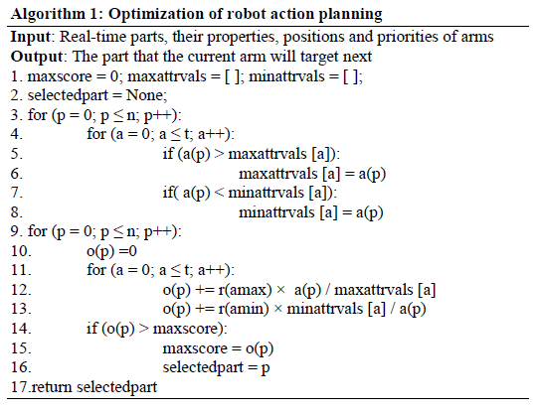
Robot action planning

Slide 26
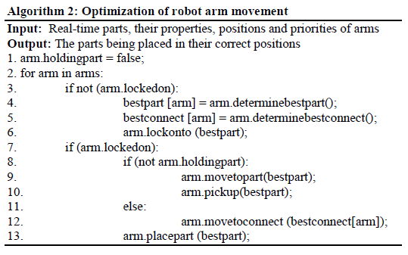
Optimization of robot arm movement

Slide 27
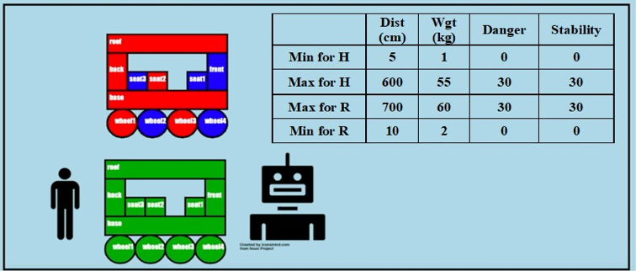
Simulation Studies

Slide 28
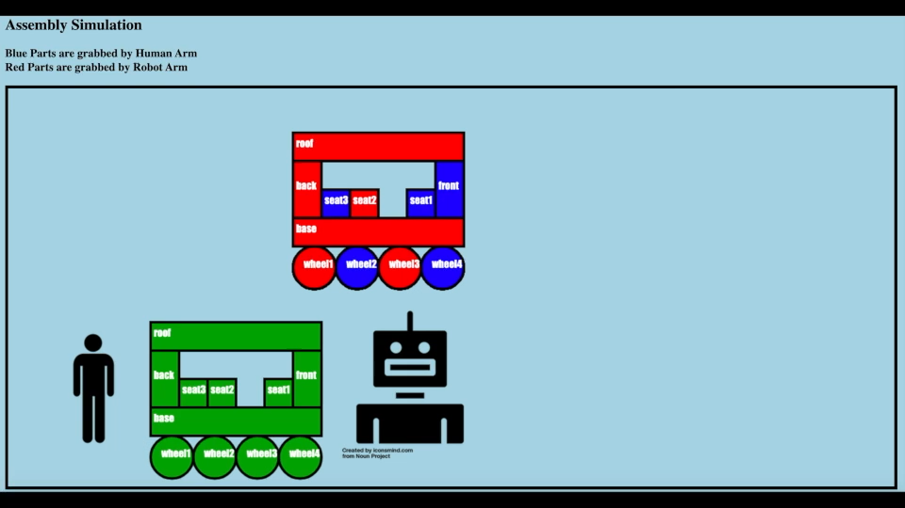
Animation

Slide 29
Simulation results

Slide 30
Discussion of Simulations
These results display the benefits of using CSK priorities in HRC.
For example, in the csk row, the human carries less weight (compared to blank, closest or norobot), thereby improving human comfort.
Note that the combination CSK option here entails humans carrying the lightest and least dangerous parts and executes in the fastest time.
Most importantly, danger is lowered with the use of CSK priorities, especially in combinationcsk (and its version3), therefore enhancing human safety.
Execution time is also found to be lower with CSK priorities. While the human travels a greater distance in csk (e.g. compared to closest), it is to be noted that this aspect is obviously less crucial than safety.
Hence, it is still in line with task optimization.

Slide 31
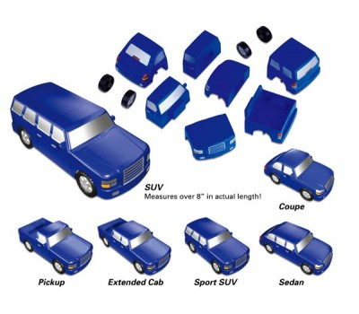
Real world Lab Experiment
Goal was to assemble a model vehicle with HRC.
Commonsense priorities were used.
Robot handed large parts to human while human handled small parts.

Slide 32
Steps for in person work
Robot hands over cargo bed of truck to human
Human attaches back wheel 1 and back wheel 2 to cargo bed
Robot hands over truck back seat to human
Robot hands over truck front seat to human
Robot hands over truck front to human
Human attaches front wheel 1 and front wheel 2 to truck front

Slide 33
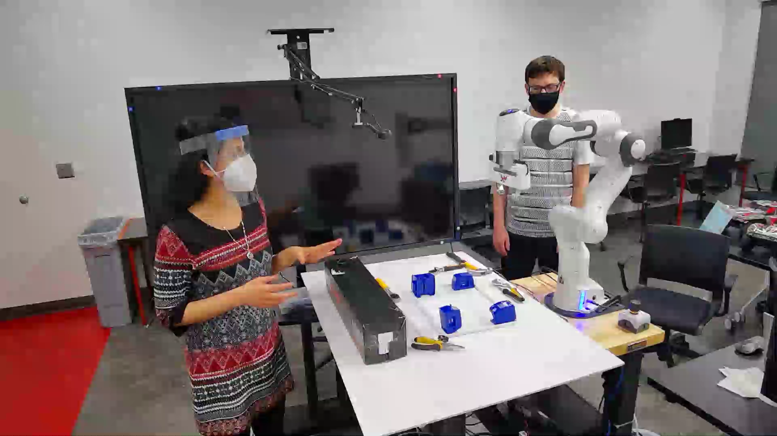
Video of In Person Work

Slide 34
Results Analysis
Results display benefits of using CSK priorities for HRC, including
Less weight carried by humans, maintaining human stamina
Lower execution time
Greater safety

Slide 35
Observations from real lab experiments
Human work is safer when robots use CS priorities.
Completion time is only slightly slower.
Two humans could do the same work, but would be exposed to more danger.

Slide 36
Discussions
In this lab setting, speaking to the robot occurs in the experimental demo, which offers a pleasant sense of collaboration through simple human-robot dialogue, even though it seems slightly unusual.
Having a robot arm aid with assembly makes the task execution more efficient and effective.
Hence, our lab experiments, over and above our simulation studies, provide task optimization in collaborative robotics, thereby paving the way for real executions in vehicle assembly in the industry.
Hence, this work on the whole makes contributions to the smart manufacturing realm, analogous to various other works as found from a survey of the literature.
It particularly addresses smart manufacturing in a data-driven context as applicable to the overall big data paradigm.

Slide 37
Conclusions
The novel contributions of our work are: providing a solution for vehicle assembly with CSK priorities to balance robot execution and aid humans in HRC; math modeling for robot action planning to provide task optimization; and conducting simulation tasks along with lab experiments to prove that humans and robots guided by CSK can be efficient in task execution while valuing human safety and comfort by protecting humans, making them carry lighter parts, making the collaborative experience very pleasant etc.
As ongoing work, we aim to add more attributes in the task execution. Future work would consider trust in HRC, with priorities changing as trust increases for greater optimization. Our further roadmap entails adding scrutiny and detection, and moving to grasp parts placed in various altering positions in the system.
This would augment human-robot collaboration for a more enhanced experience in smart manufacturing.

Slide 38
Future Work
Adding more attributes
Testing for larger and more complicated real world tasks
Having the robot arm detect part positions

Slide 39
Acknowledgements
I would like to that my thesis advisors Dr. Aparna Varde and Dr. Weitian Wang for their guidance.
I would like to thank my family for their support.

Slide 40
Works Cited
[1] J. Suchan and M. Bhatt, “Commonsense Scene Semantics for Cognitive Robotics: Towards Grounding Embodied Visuo-Locomotive Interactions,” 2017, doi: 10.1109/ICCVW.2017.93.
[2] Y. Chen et al., “A Robotic Lift Assister: A Smart Companion for Heavy Payload Transport and Manipulation in Automotive Assembly,” IEEE Robot. Autom. Mag., vol. 25, no. 2, pp. 107–119, 2018.
[3] D. E. Whitney, C. A. Lozinski, and J. M. Rourke, “Industrial robot forward calibration method and results,” J. Dyn. Syst. Meas. Control. Trans. ASME, vol. 108, no. 1, pp. 1–8, 1986, doi: 10.1115/1.3143737.
[4] T. Pettersen, J. Pretlove, C. Skourup, T. Engedal, and T. Lokstad, “Augmented reality for programming industrial robots,” in The Second IEEE and ACM International Symposium on Mixed and Augmented Reality, 2003. Proceedings., 2003, pp. 319–320.
[5] J. Iqbal, R. U. Islam, S. Z. Abbas, A. A. Khan, and S. A. Ajwad, “Automating industrial tasks through mechatronic systems–A review of robotics in industrial perspective,” Teh. Vjesn., vol. 23, no. 3, pp. 917–924, 2016.
[6] K.-D. Thoben, S. Wiesner, and T. Wuest, “‘Industrie 4.0’ and smart manufacturing-a review of research issues and application examples,” Int. J. Autom. Technol., vol. 11, no. 1, pp. 4–16, 2017.
[7] B. Hayes and B. Scassellati, “Autonomously constructing hierarchical task networks for planning and human-robot collaboration,” 2016, doi: 10.1109/ICRA.2016.7487760.
[8] N. Tandon, A. S. Varde, and G. de Melo, “Commonsense Knowledge in Machine Intelligence,” ACM SIGMOD Rec., 2018, doi: 10.1145/3186549.3186562.
[9] N. Tandon, G. De Melo, and G. Weikum, “WebChild 2.0: Fine-grained commonsense knowledge distillation,” 2017, doi: 10.18653/v1/P17-4020.
[10] E. Davis and G. Marcus, “Commonsense Reasoning and Commonsense Knowledge in Artificial Intelligence.” [Online]. Available: http://cs.nyu.edu/faculty/davise/papers/WS.html.
[11] J. Redmon, S. Divvala, R. Girshick, and A. Farhadi, “You only look once: Unified, real-time object detection,” 2016, doi: 10.1109/CVPR.2016.91.
[12] A. Kilgarriff and C. Fellbaum, “WordNet: An Electronic Lexical Database,” Language (Baltim)., 2000, doi: 10.2307/417141.
[13] F. M. Suchanek, G. Kasneci, and G. Weikum, “Yago: A Core of Semantic Knowledge,” 2006.
[14] J. Lehmann et al., “DBpedia - A large-scale, multilingual knowledge base extracted from Wikipedia,” Semant. Web, vol. 6, no. 2, pp. 167–195, 2015, doi: 10.3233/SW-140134.
[15] H. Liu and P. Singh, “ConceptNet - a practical commonsense reasoning tool-kit,” BT Technol. J., vol. 22, no. 4, pp. 211–226, 2004, doi: 10.1023/B:BTTJ.0000047600.45421.6d.
[16] “Quartz Weekly Obsession: Google Translate,” Quartz, 2020. https://qz.com/emails/quartz-obsession/1781599/.
[17] A. Varghese, A. S. Varde, J. Peng, and E. Fitzpatrick, “A Framework for Collocation Error Correction in Web Pages and Text Documents.”

Slide 41
Works Cited Continued
[18] S. Pellegrinelli, A. Orlandini, N. Pedrocchi, A. Umbrico, and T. Tolio, “Motion planning and scheduling for human and industrial-robot collaboration,” CIRP Ann. - Manuf. Technol., 2017, doi: 10.1016/j.cirp.2017.04.095.
[19] B. Mutlu, A. Terrell, and C. Huang, “Coordination Mechanisms in Human-Robot Collaboration,” 2013.
[20] J. Richer and J. L. Drury, “A video game-based framework for analyzing human-robot interaction: characterizing interface design in real-time interactive multimedia applications,” in Proceedings of the 1st ACM SIGCHI/SIGART conference on human-robot interaction, 2006, pp. 266–273.
[21] W. Wang, Y. Chen, and Y. Jia, “Which way is the best?: Evaluation and optimization of dual-arm robot path planning for human-robot collaborative tasks in smart manufacturing contexts,” ASME 2019 Dyn. Syst. Control Conf. DSCC 2019, vol. 1, no. 1, 2019, doi: 10.1115/DSCC2019-9143.
[22] Y. Guo and L. E. Parker, “A distributed and optimal motion planning approach for multiple mobile robots,” in Proceedings 2002 IEEE International Conference on Robotics and Automation (Cat. No. 02CH37292), 2002, vol. 3, pp. 2612–2619.
[23] E. Matheson, R. Minto, E. G. G. Zampieri, M. Faccio, and G. Rosati, “Human-robot collaboration in manufacturing applications: A review,” Robotics. 2019, doi: 10.3390/robotics8040100.
[24] M. Chen, S. Nikolaidis, H. Soh, D. Hsu, and S. Srinivasa, “Planning with Trust for Human-Robot Collaboration,” 2018, doi: 10.1145/3171221.3171264.
[25] B. D. Argall, S. Chernova, M. Veloso, and B. Browning, “A survey of robot learning from demonstration,” Rob. Auton. Syst., 2009, doi: 10.1016/j.robot.2008.10.024.
[26] J. P. Vasconez, G. A. Kantor, and F. A. Auat Cheein, “Human–robot interaction in agriculture: A survey and current challenges,” Biosystems Engineering. 2019, doi: 10.1016/j.biosystemseng.2018.12.005.
[27] “SAE International Releases Updated Visual Chart for Its ‘Levels of Driving Automation’ Standard for Self-Driving Vehicles,” SAE, 2018. https://www.sae.org/news/press-room/2018/12/sae-international-releases-updated-visual-chart-for-its-“levels-of-driving-automation”-standard-for-self-driving-vehicles.
[28] R. Beard et al., “Autonomous vehicle technologies for small fixed-wing UAVs,” J. Aerosp. Comput. Inf. Commun., vol. 2, no. 1, pp. 92–108, 2005, doi: 10.2514/1.8371.
[29] “On the Road to Full Autonomy: Self-Driving Cars Will Rely on AI and Innovative Memory,” Micron Lettered in White. .
[30] A. Pandey, M. Puri, and A. Varde, “Object detection with neural models, deep learning and common sense to aid smart mobility,” 2018, doi: 10.1109/ICTAI.2018.00134.
[31] P. Persaud, A. S. Varde, and S. Robila, “Enhancing autonomous vehicles with commonsense: Smart mobility in smart cities,” 2018, doi: 10.1109/ICTAI.2017.00155.
[32] U. E. Manawadu, M. Kamezaki, M. Ishikawa, T. Kawano, and S. Sugano, “A hand gesture based driver-vehicle interface to control lateral and longitudinal motions of an autonomous vehicle,” in 2016 IEEE International Conference on Systems, Man, and Cybernetics, SMC 2016 - Conference Proceedings, 2017, pp. 1785–1790, doi: 10.1109/SMC.2016.7844497.
[33] F. Tao, Q. Qi, A. Liu, and A. Kusiak, “Data-driven smart manufacturing,” J. Manuf. Syst., 2018, doi: 10.1016/j.jmsy.2018.01.006.
[34] P. O’Donovan, K. Leahy, K. Bruton, and D. T. J. O’Sullivan, “An industrial big data pipeline for data-driven analytics maintenance applications in large-scale smart manufacturing facilities,” J. Big Data, 2015, doi: 10.1186/s40537-015-0034-z.

Slide 42
Image Citations
https://www.publicdomainpictures.net/en/view-image.php?image=178673&picture=stormy-sky
https://www.universal-robots.com/blog/know-your-machine-industrial-robots-vs-cobots/
https://www.assemblymag.com/articles/91862-human-robot-collaboration-comes-of-age
http://web.eecs.utk.edu/~leparker/publications/ICRA02_Guo.pdf
https://www.i-scoop.eu/industry-4-0/manufacturing-industry/

